Slide 1


Slide 2
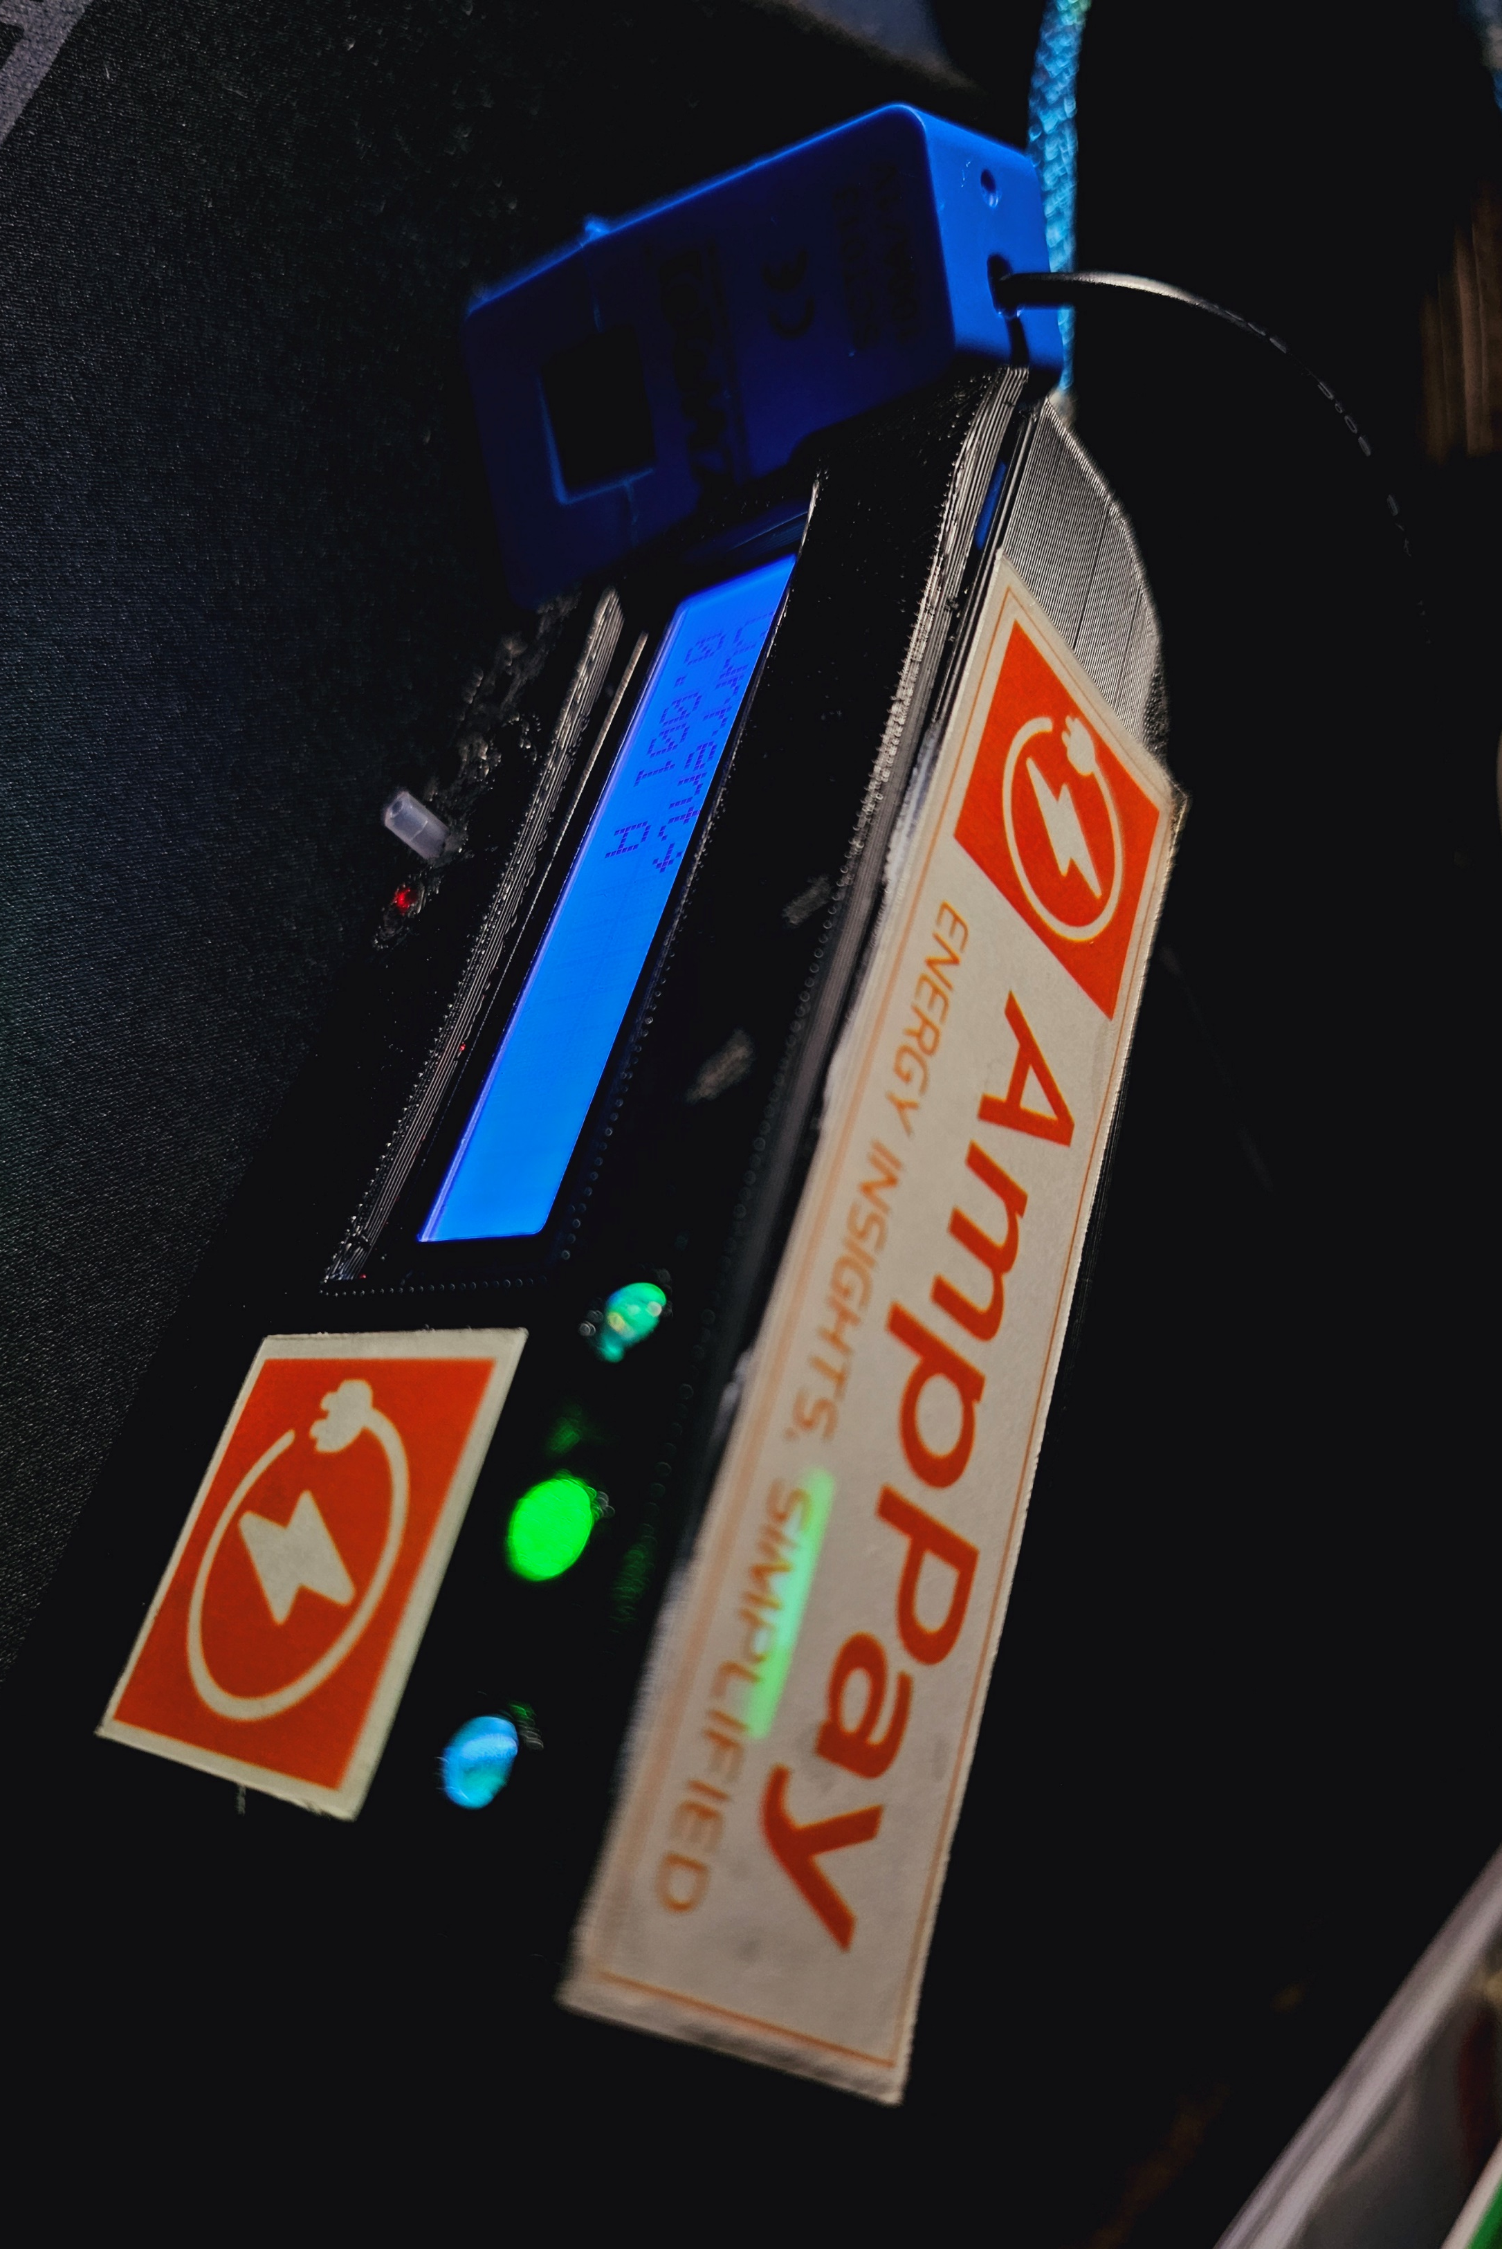
What Is AmpPay Currently Capable of?

Slide 3
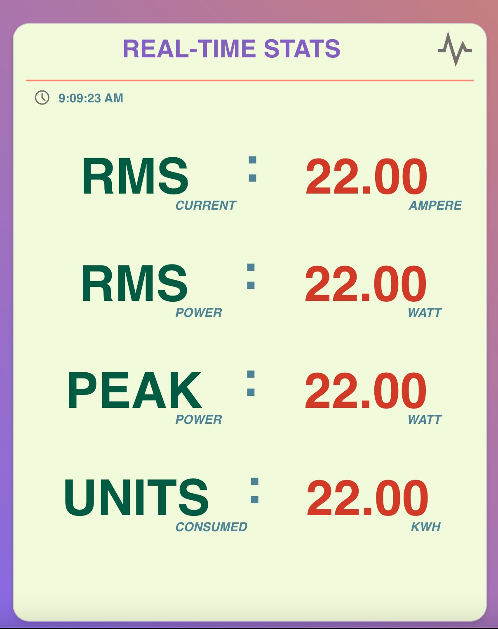
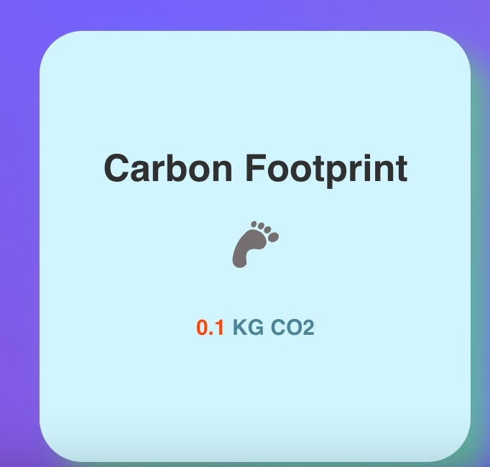
Real time stream of relevant statistics.
Average Current
Average Power
Peak Power
Units Consumed
Carbon Footprint

Slide 4
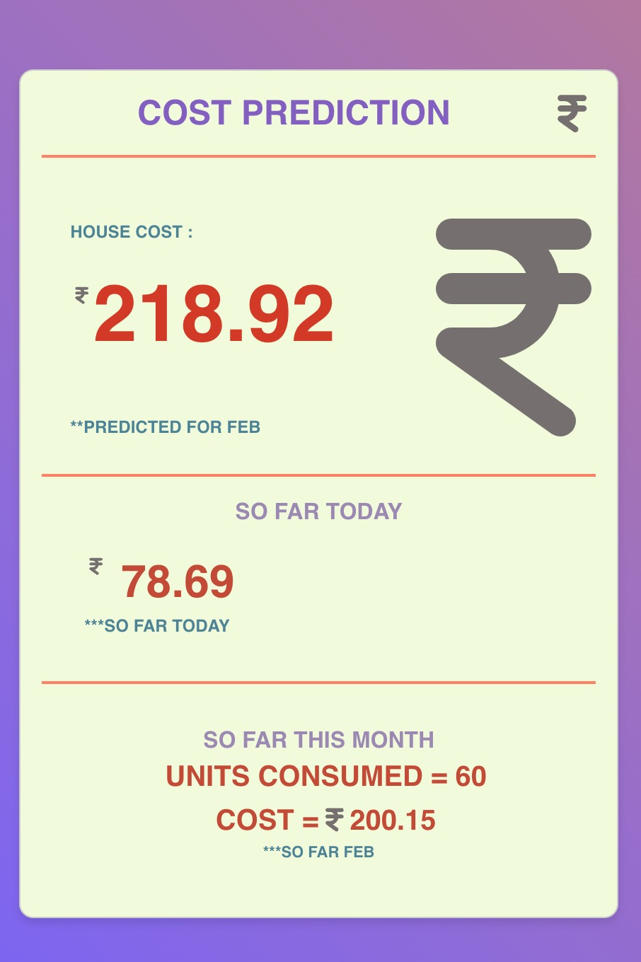
Predictive Billing Powered by Machine Learning Models.
Predictive billing for each month or day
+
Track monthly expenses up to the present day, in real-time.

Slide 5
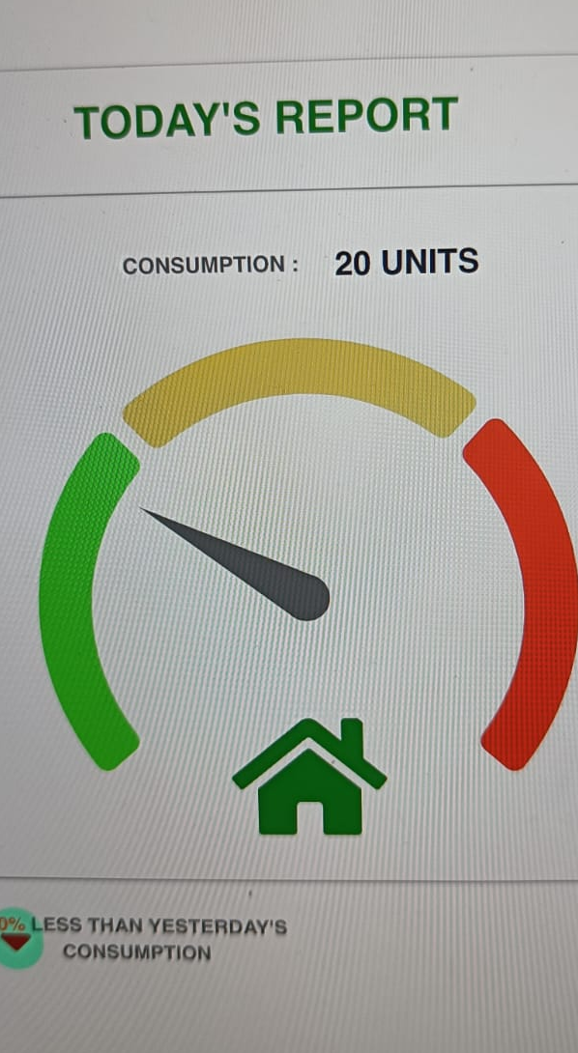
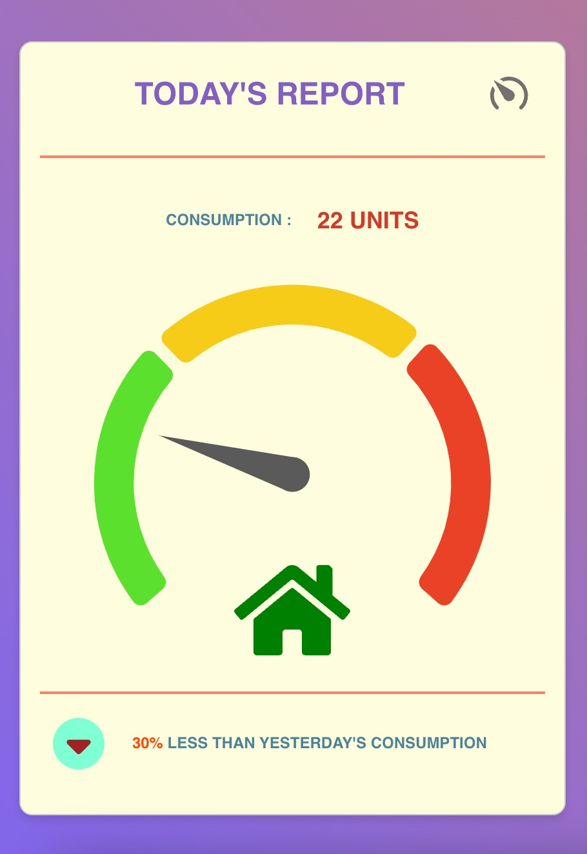
Personalized consumption limit alert system.
Manage daily consumption
and save up on
your bills.

Slide 6
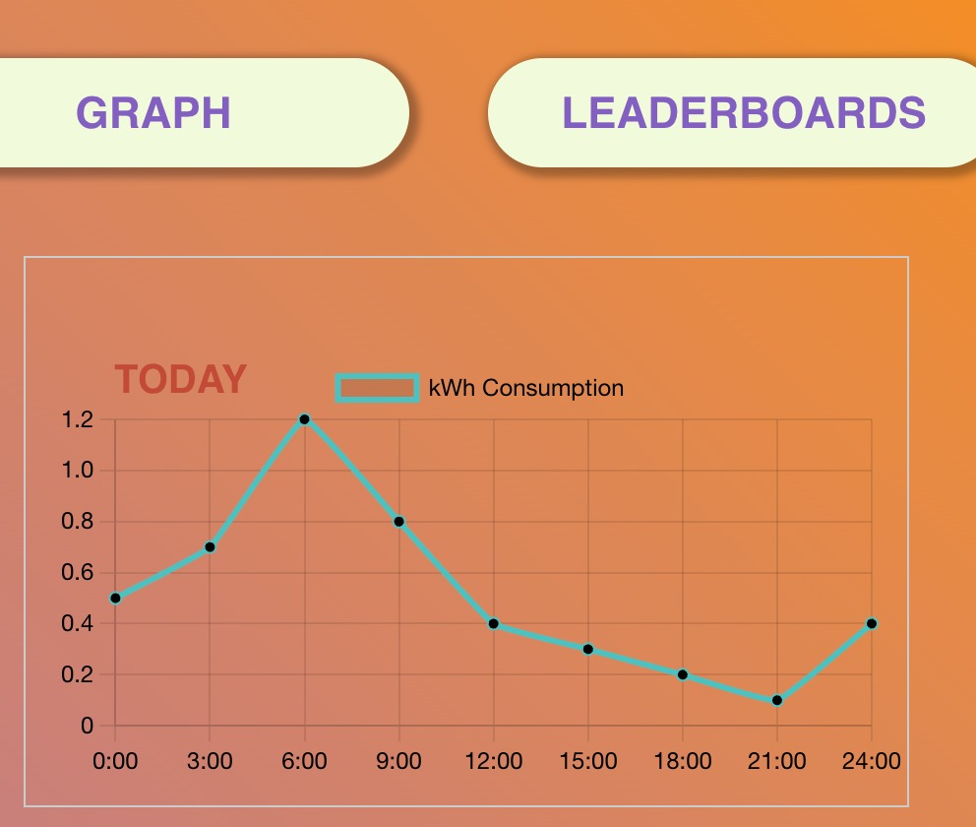
Visual Representation of daily , weekly and monthly consumption.
A more friendly and easy UI.

Slide 7

Environmental Aspect
Carbon footprint assessment and awareness.
Efficiency leaderboards.
Notification system
Increased energy awareness

Slide 8
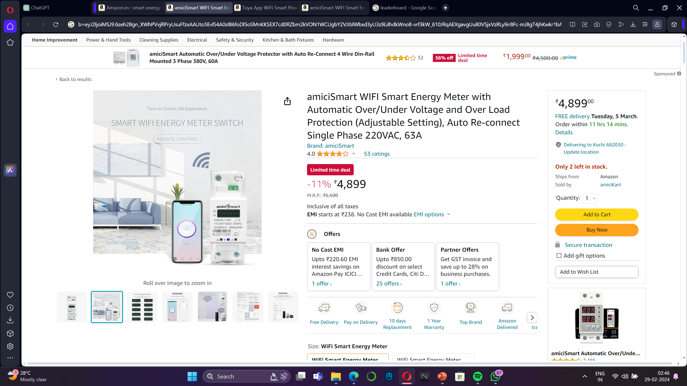
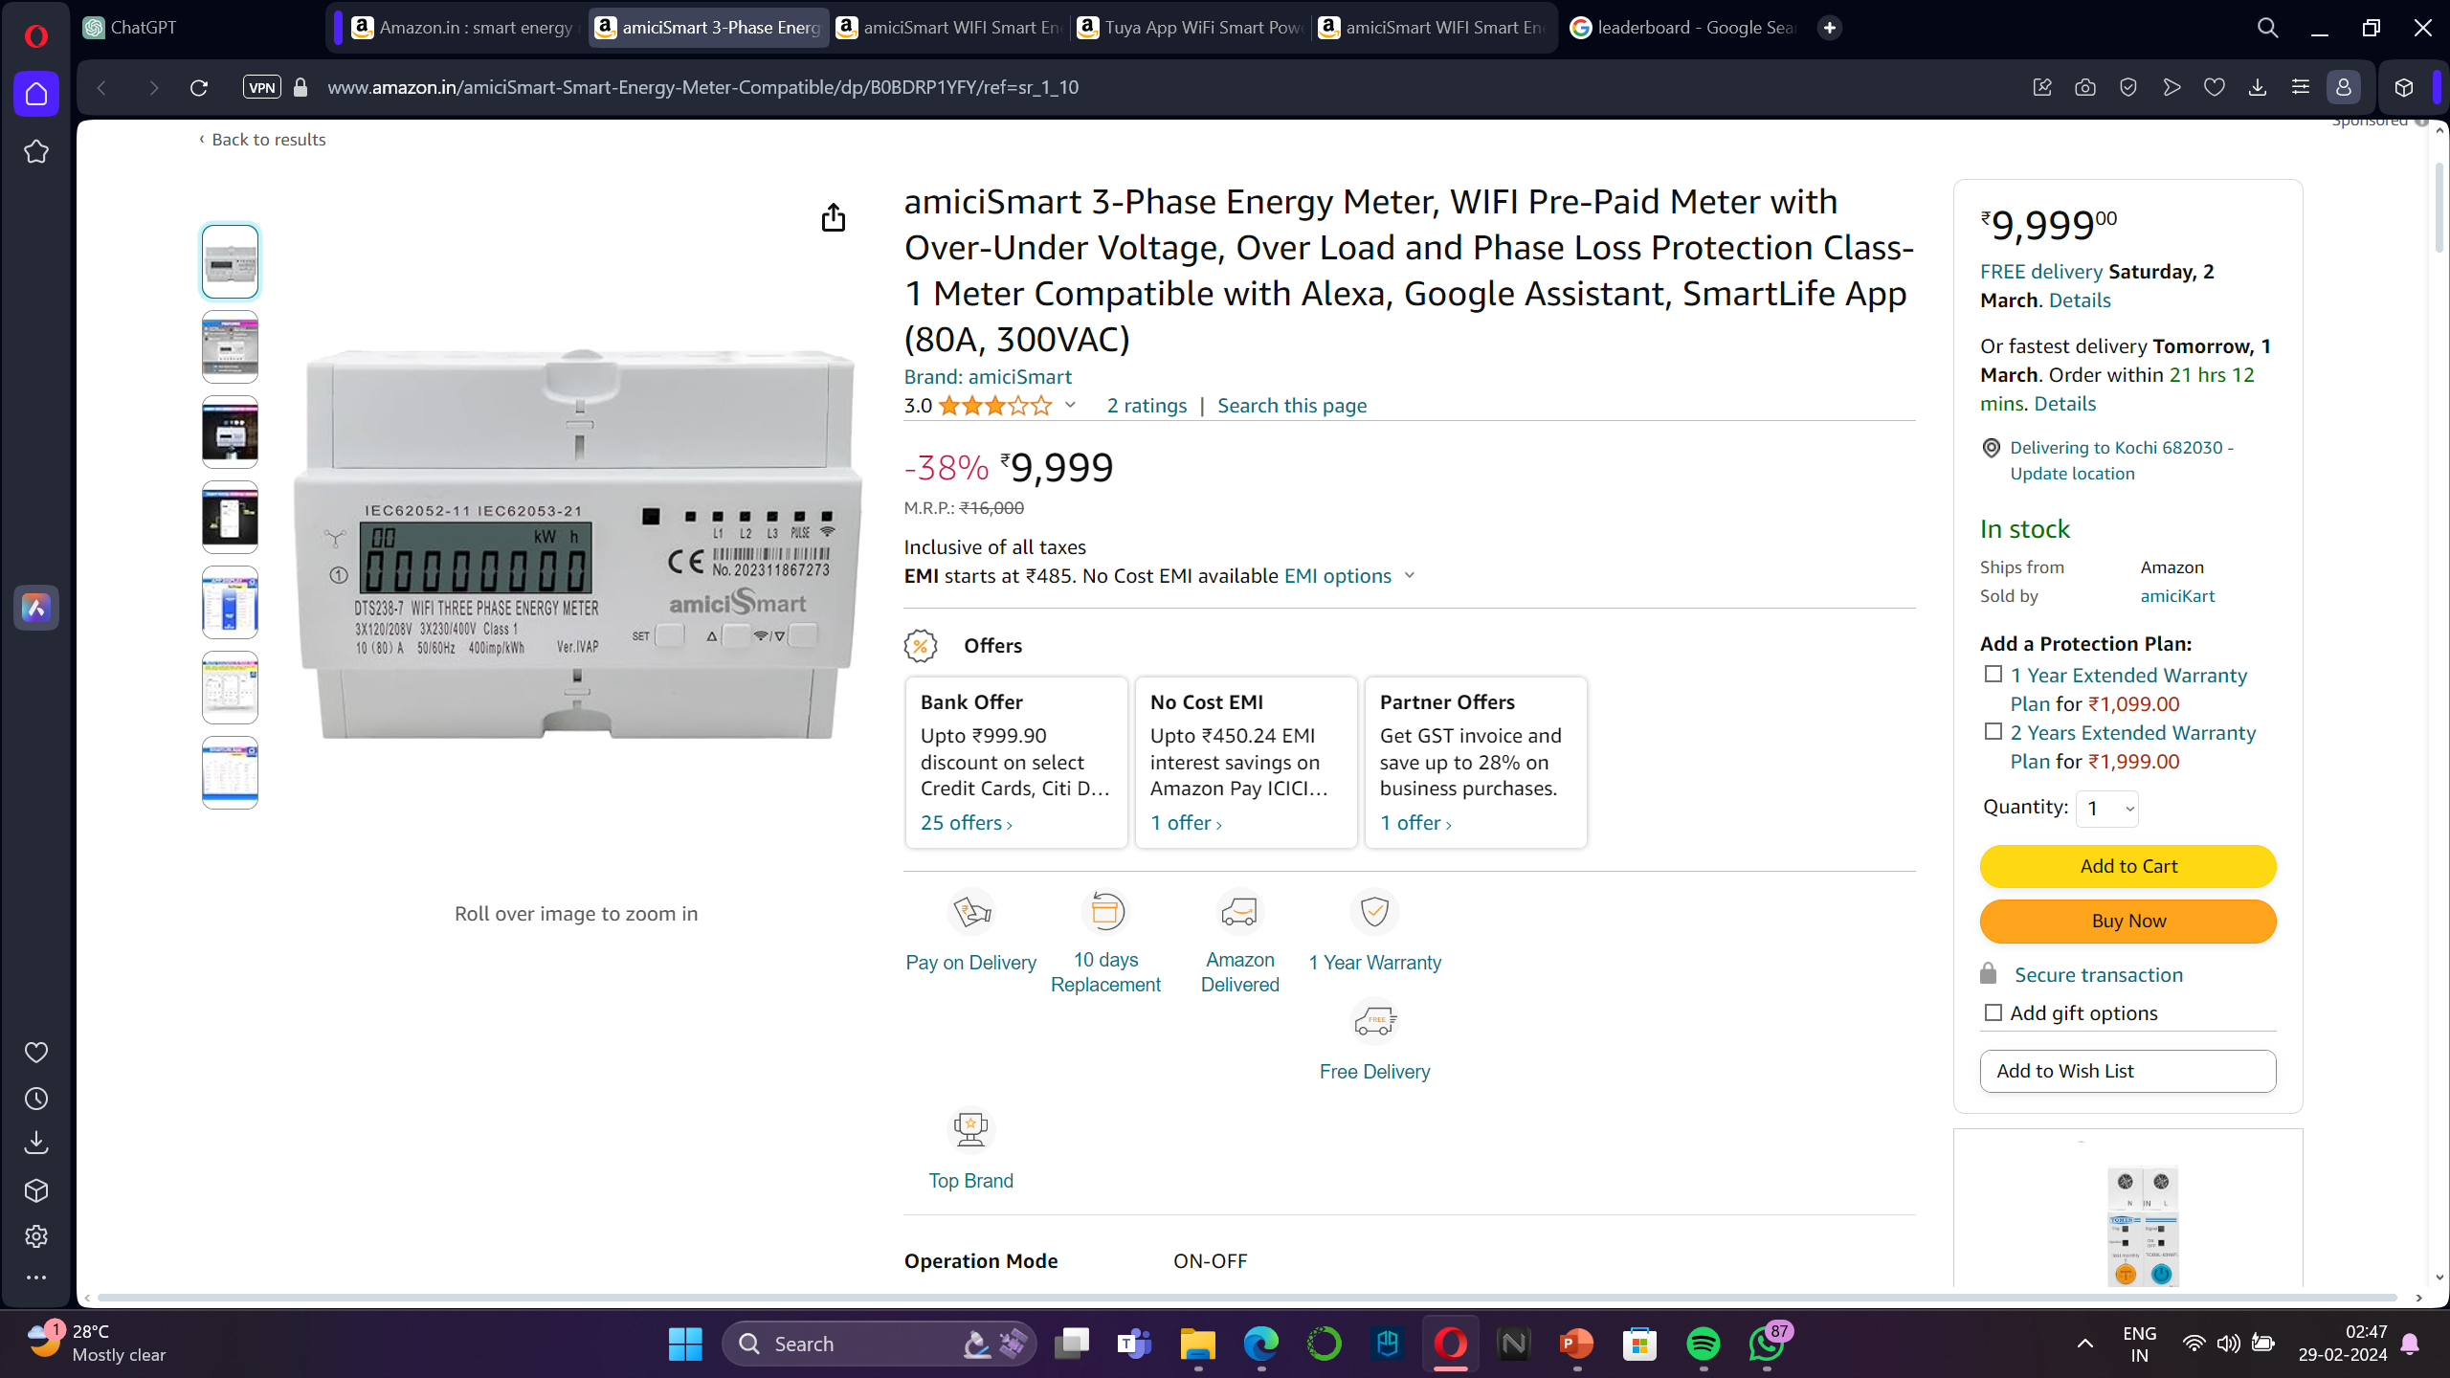
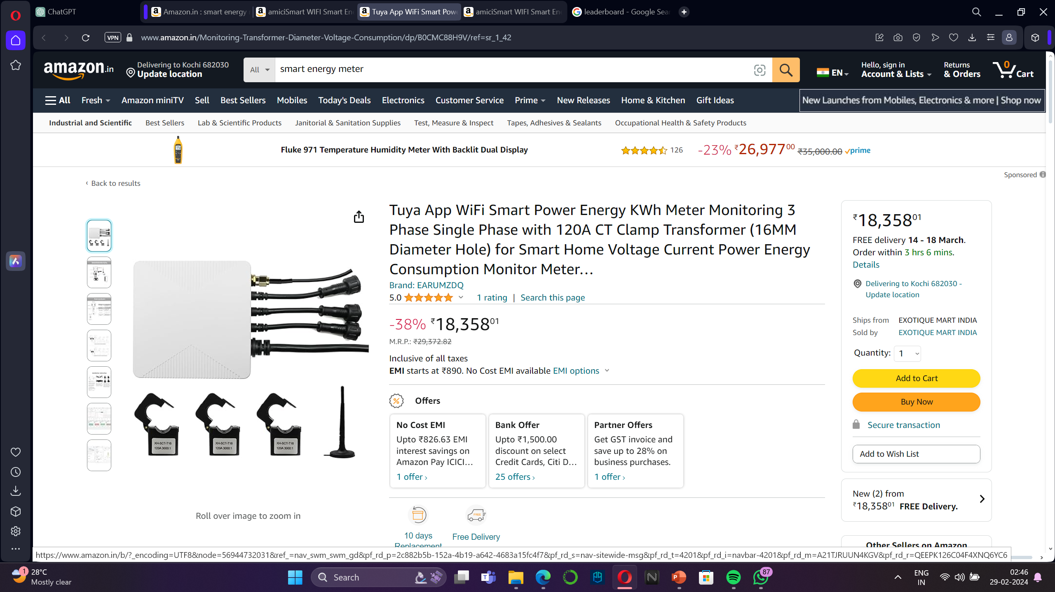
Revenue model
Potential for Partnership: Collaboration opportunities with energy providers and smart home device manufacturers.
AmpPay V1 –
Approx. ₹2700
AmpPay V2 –
Approx. ₹2200

Slide 9
Revenue model
Subscription Model: Recurring subscription fees for premium features

Slide 10
Revenue model
Data Analytics Service: Offering anonymized data for research and analytics.

Slide 11
Revenue model
Growing demand for energy management solutions
Emphasis on environmental impact
Era of AI in consumer goods

Slide 12
What's Next for AmpPay: Future Features and Capabilities"

Slide 13

Building Management System
integration.
Smart Home Ecosystem integration.
(Alexa and Google Assistant)
Zone monitoring and control.
Power Modes
Timer control.
App support for Android and IOS.

Slide 14



Improved consumption alerts.
Improved machine learning models
Improved energy meter
Push notification / SMS delivery of consumption , power outage , fault alerts.
GSM module included
Overload protection
Over/under voltage protection
Better Sensors
Better predictive billing

Slide 15

Efficiency leadership boards.
Compare your usage with buildings of similar size.
Efficiency rankings based on carbon footprint.
Efficiency Reports
Month end detailed reports to review usage patterns.

Slide 16

Expected Dev Time
2-3 months

